Slide 1
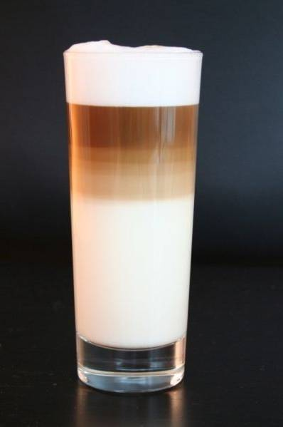
Incompletely mixed systems Week 2 (with constant system volume)
Saket Pande
CIE4400

Slide 2
What topics will be covered?
Advection and advection with dispersion systems at steady state
Explicit Euler scheme for solving steady state ADE with decay
Systems containing diffusion, advection and decay simultaneously
Non-steady state solution for Advection and Diffusion equation with instantaneous point loading
Rhine Alarm Model

Slide 3

Advection only
Center of mass of a differential pollutant mass flows with constant velocity U
$$Mass Flux: J=Uc$$
1D plug flow model
Time step t₀
river
wasteload
real profile
Time step t₁
ideal plug flow

Slide 4
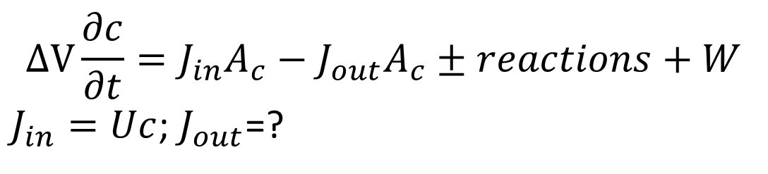
1D Plug Flow Model
A_{c}
W
A_{c}
J_{in}
J_{out}
∆x
$$∆V\frac{∂c}{∂t}=J_{in}A_{c}−J_{out}A_{c}±reactions+W$$
$J_{in}=Uc$; $J_{out}$=?
Formulate the differential equation for reaction = k∆Vc, and W= 0

Slide 5
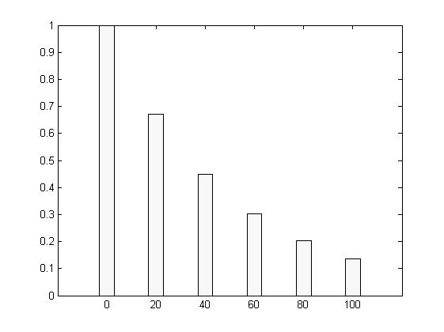
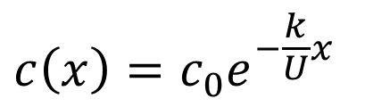
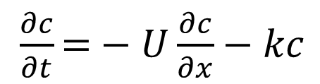
Steady state solution for 1D plug flow model with first order kinetics
Let c(t, x=0) = c₀
$\frac{∂c}{∂t}\text{=}−U\frac{∂c}{∂x}−kc$
Steady state
solution?
c(x) (mg/L)
$$c\left(x\right)=c_{0}e^{−\frac{k}{U}x}$$
For example:
c₀=1mg/L, k= 2/hr, U = 100 m/hr, Ac = 10 sq m, L = 100 m
X (m)

Slide 6

Cascade Model of an elongated tank
Feed forward system with first order decay at steady state
A well mixed reservoir of volume V
c_{in}
c_{out}
Q
Q
n well mixed reservoirs
∆x
Solution:

Slide 7
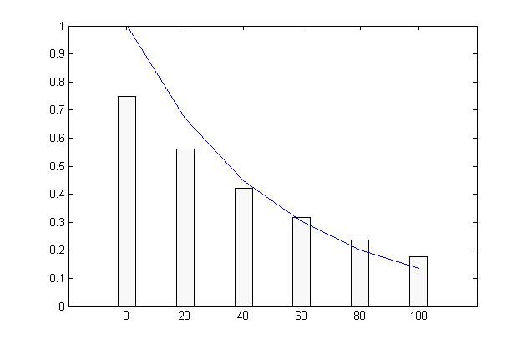
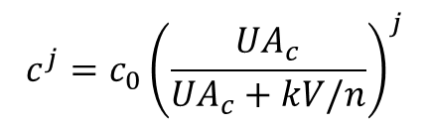
Cascade Model: feedforward system of completely mixed tanks
If V is the total control volume and there are n=6 well mixed reservoirs.
Concentration in the j^{th} reservoir is given by:
Plug Flow model
c(x) (mg/L)
Cascade model
X (m)
When is cascade model equivalent to 1D plug flow model ?

Slide 8
Approximating incompletely mixed condition by piecewise completely mixed systems
Fundamental to modeling heterogeneous concentration fields
For example: cascade model approached plug flow model at n →∞.
How is the formulation of a cascade model different from Plug flow model formulation?

Slide 9
Extending the completely mixed system model
Incomplete mixing: network of box models
Water compartments
Fluxes between compartments ?

Slide 10
Mixed flow model (Advection + Dispersion)
W
A_{c}
J_{in}
J_{out}
∆x
Advective and dispersive fluxes are additive.
Formulate the mass balance equation (in groups)
Solution:

Slide 11
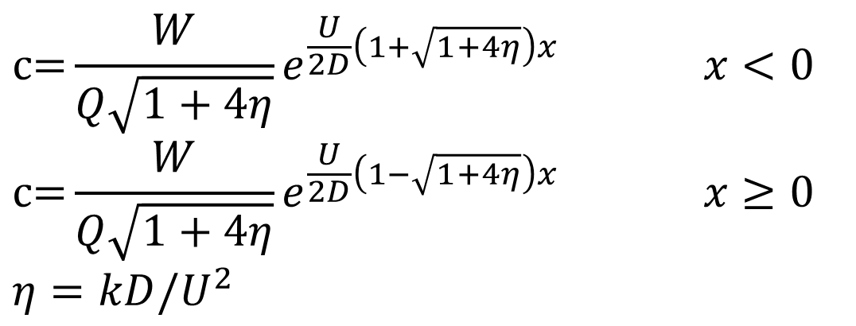
Steady state solution for Mixed flow model
Due to point (continuous) loading W(x) = Wδ(0) at x = 0
$$c\text{=}\frac{W}{Q\sqrt{1+4η}}e^{\frac{U}{2D}\left(1+\sqrt{1+4η}\right)x} x<0$$
$$c\text{=}\frac{W}{Q\sqrt{1+4η}}e^{\frac{U}{2D}\left(1−\sqrt{1+4η}\right)x} x≥0$$
$$η=kD/U^{2}$$
Obtain steady state solution for Plug flow model from this?

Slide 12
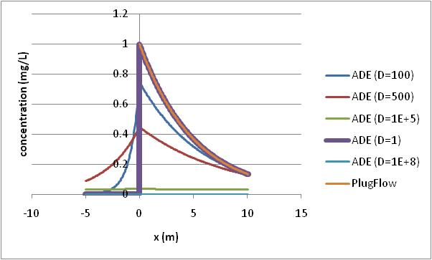
Steady state solution for Mixed flow model

Slide 13
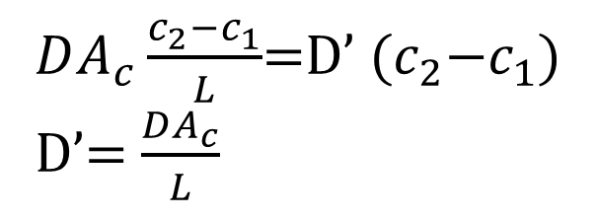
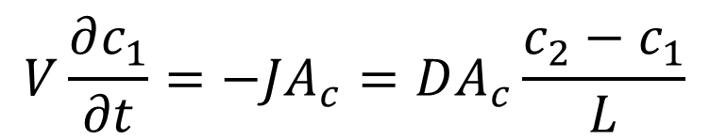
Dimensionless analysis
Let x*=x/L (length of the model), c*=c/c₀. Substituting it in the steady state equation
0$\text{=}−\frac{∂c∗}{∂x∗}+\frac{D}{UL}\frac{∂^{2}c∗}{∂{x∗}^{2}}−\frac{kL}{u}c∗$
Peclet number $P_{e}=LU/D$
Damkohler number $D_{a}=kL/U$
$P_{e}$>10 => ?
$P_{e}$<0.1 => ?

Slide 14
Numerics for steady state formulations
Control volume approach (with no dipersion at boundary)
Numerical dispersion

Slide 15
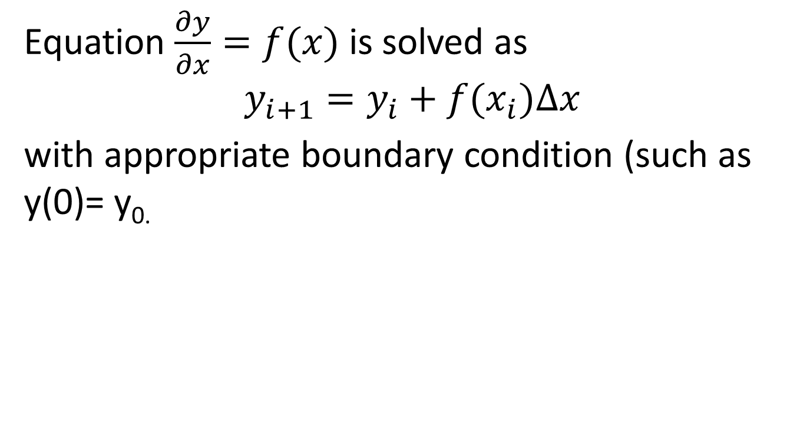
Explicit Euler scheme
Equation $\frac{∂y}{∂x}=f(x)$ is solved as
$$y_{i+1}=y_{i}+f(x_{i})∆x$$
with appropriate boundary condition (such as y(0)= y_{0.}

Slide 16





Control Volume Approach (1)
$$A_{c}$$
i = 1 to n
i-1
i
$$D^{′}=DA_{c}/∆x$$
i+1
$$V_{i}=V=A_{c}∆x$$
$$∆x$$
Divide the tube into n control volumes
Describe mass balance for each control volume except for i = 1 and n:
$$0=W_{i}+Q_{i−1,i}c_{i−1}−Q_{i,i+1}c_{i}+{D′}_{i−1,i}\left(c_{i−1}−c_{i}\right)−{D′}_{i,i+1}\left(c_{i}−c_{i+1}\right)−k_{i}V_{i}c_{i}$$
Collecting the terms, for i≠1 and i ≠ n:
$$W_{i}=a_{i,i−1}c_{i−1}−a_{i,i}c_{i}+a_{i,i+1}c_{i+1}$$

Slide 17
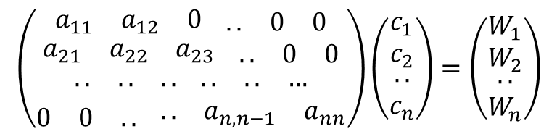
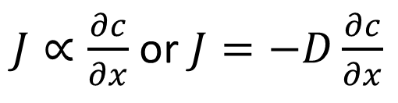
Control Volume approach (2)
$$a_{i,i−1}=−Q_{i−1,i}−{D′}_{i−1,i}$$
$$a_{i,i}=Q_{i,i+1}+{D′}_{i−1,i}+{D′}_{i,i+1}+k_{i}V_{i}$$
$$a_{i,i+1}=−{D′}_{i,i+1}$$
What will be the equations for i = 1 and n? Remember no dispersion at the boundaries and c(0) = c_{o}.
Finally solve the following system of equations
$$\left(\begin{aligned}\begin{matrix}a_{11} & a_{12} & 0\end{matrix} \begin{matrix}.. & 0 & 0\end{matrix} \\ \begin{matrix}a_{21} & a_{22} & a_{23}\end{matrix} \begin{matrix}.. & 0 & 0\end{matrix} \\ \begin{matrix}.. & .. & ..\end{matrix} \begin{matrix}.. & .. & …\end{matrix} \\ \begin{matrix}0 & 0 & ..\end{matrix} \begin{matrix}.. & a_{n,n−1} & a_{nn}\end{matrix}\end{aligned}\right)\left(\begin{matrix}\begin{aligned}c_{1} \\ c_{2}\end{aligned} \\ .. \\ c_{n}\end{matrix}\right)=\left(\begin{matrix}\begin{aligned}W_{1} \\ W_{2}\end{aligned} \\ .. \\ W_{n}\end{matrix}\right)$$

Slide 18
Solve numerically the ADE at steady state (group work)
A_{c}
L
c_{in}
c_{out}
Q
Q
∆x
Formulate the system of equations in matrix form for the above tank with Ac = 10 m², L = 100m, U = 100 m/hr, k = 2 hr⁻¹, cin = 1 mg/L, D = 2000 m²/hr and n = 5.

Slide 19
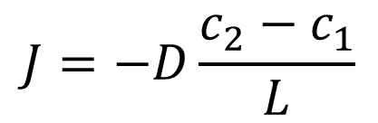
Synthesis
$$\left[\begin{matrix}2400 & −1000 & 0 & 0 & 0 \\ −2000 & 3400 & −1000 & 0 & 0 \\ 0 & −2000 & 3400 & −1000 & 0 \\ 0 & 0 & −2000 & 3400 & −1000 \\ 0 & 0 & 0 & −2000 & 2400\end{matrix}\right]\left[\begin{matrix}c_{1} \\ c_{2} \\ c_{3} \\ c_{4} \\ c_{5}\end{matrix}\right]=\left[\begin{matrix}1000 \\ 0 \\ 0 \\ 0 \\ 0\end{matrix}\right]$$

Slide 20
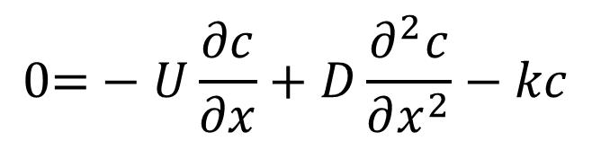


Numerical dispersion
Due to finite difference approximation of first derivative of c in ADE at steady state
Can be estimated based on Taylor series expansion of $\frac{∂c}{∂x}$ in
$$\text{0=}−U\frac{∂c}{∂x}+D\frac{∂^{2}c}{∂x^{2}}−kc$$
If $\frac{∂c}{∂x}$ substituted by $\left(c_{i+1}−c_{i}\right)/∆x$ in the above, numerical dispersion is given by quantity $∆xU/2$

Slide 21
End of hour 1

Slide 22
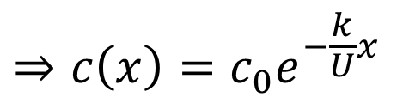


Solution for Advection Equation with first order kinetics
Let c(0) = c₀ δ(t=0,x=0)
c(x) (mg/L)
$$=c_{0}e^{−kt} for t=x/U$$
$$= ? for t≠x/U$$
x=U*t (m)
Moving versus fixed observer: decay observed if observer moves with velocity U. (If no decay, then what?)

Slide 23
Solution for Advection Equation
c
c_{o}
Instantaneous point load
0
x
x’
c₀=1mg/L, k= 2/hr, U = 100 m/hr, x’ = 1km. What is the concentration at x’ for t =1 hr, 10 hr, 100 hr?
How long will it take for initial concentration to go to 10% of its value? At what distance?

Slide 24
Solution to diffusion equation (for instantaneous point spill)

Slide 25
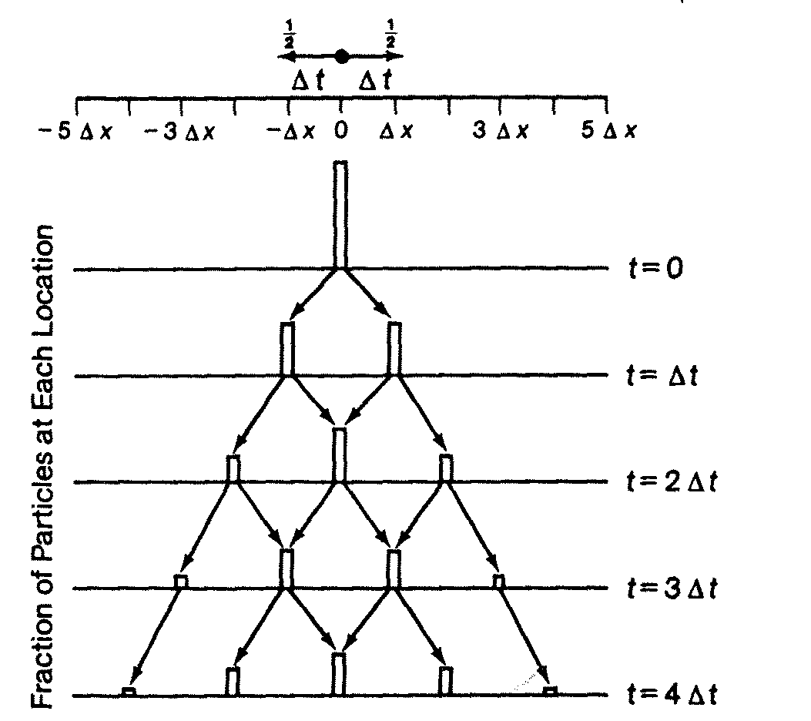
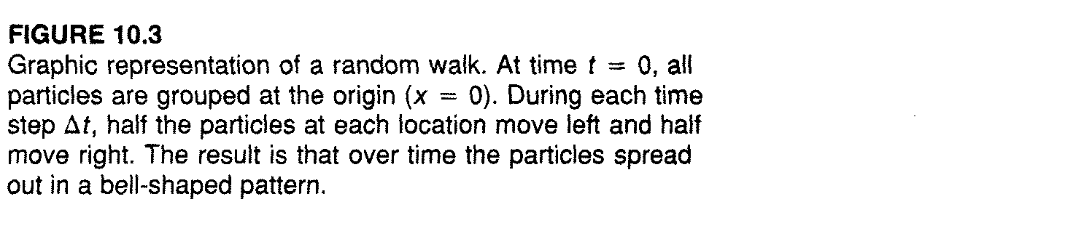
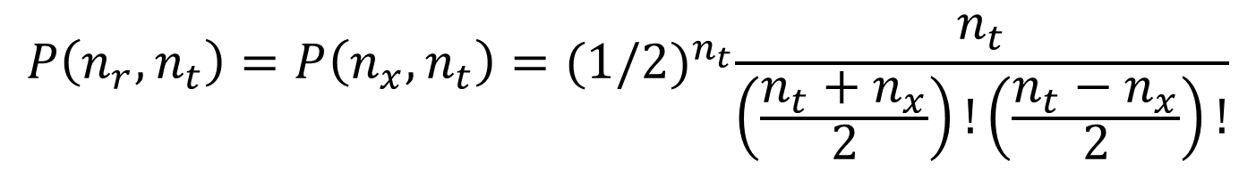
Solution to diffusion equation 1 (for instantaneous point spill)
Source: Surface Water Quality Modeling by Steven
Chapra
$$P\left(n_{r},n_{t}\right)=P\left(n_{x},n_{t}\right)={(1/2)}^{n_{t}}\frac{n_{t}}{\left(\frac{n_{t}+n_{x}}{2}\right)!\left(\frac{n_{t}−n_{x}}{2}\right)!}$$
n_{x}: total number of steps upto location x, n_{r}: number of steps to the right, n_{l} = number of steps to the left, n_{t} = total number of steps

Slide 26
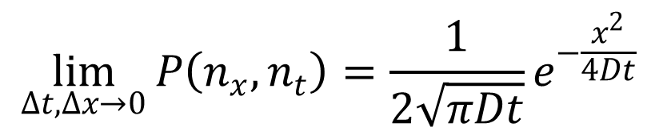
Solution to diffusion equation 3 (for instantaneous point spill)
$$\lim_{Δt,Δx→0}{P\left(n_{x},n_{t}\right)}=\frac{1}{2\sqrt{πDt}}e^{−\frac{x^{2}}{4Dt}}$$
For t = n_{t}Δt, x=n_{x} Δx and D (diffusion coefficient) = Δx²/2 Δt.

Slide 27
Remember this example?
Evolution of a colored droplet on lake surface
What happens to concentration
Top view
t0
y
t1
x
t2
c(x)
c(x)
t1<t2
at t1
at t2
x

Slide 28
ADE equation with first order decay process
$\frac{∂c}{∂t}\text{=}−U\frac{∂c}{∂x}+D\frac{∂^{2}c}{∂x^{2}}−kc$
c
x
1) How would the concentration distribution propagate when some instantaneous point spill leading to c(x=0,t=0)=c0 and no reactions or additional loading? (in groups)

Slide 29
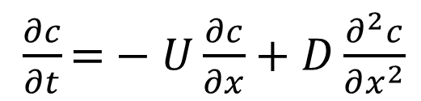
It will look like this..
$\frac{∂c}{∂t}\text{=}−U\frac{∂c}{∂x}+D\frac{∂^{2}c}{∂x^{2}}$
at t=0
at t1
at t2
c
x
x1=U * t1
x2=U * t2

Slide 30
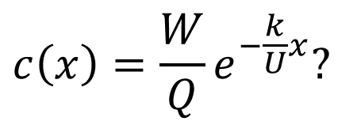
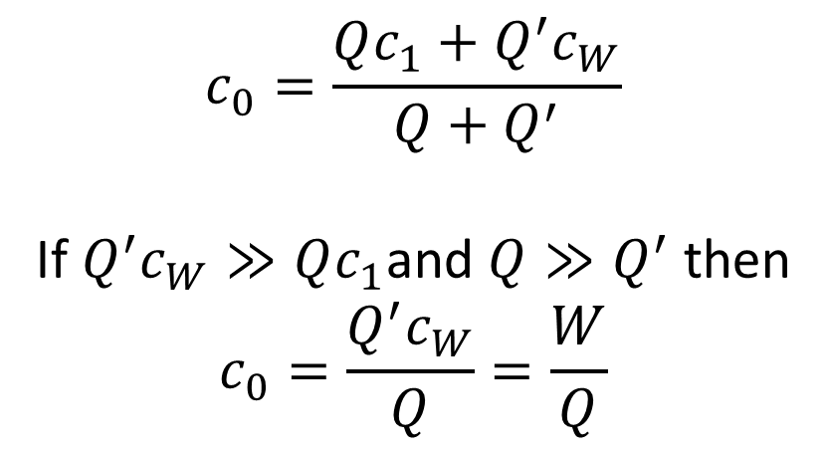


Why c₀ = W/Q under no diffusion when the point (continuous) loading at x = 0 is W
$$Q{′c}_{W}=W$$
$$Qc_{1}$$
$$c_{0}$$
$$Q_{2}c_{0}$$
$$c\left(x\right)=\frac{W}{Q}e^{−\frac{k}{U}x}?$$
$$Qc_{1}+Q^{′}c_{W}−Q_{2}c_{0}=0$$
$$Q+Q^{′}=Q_{2}$$
x=0
Differential element, well mixed and at steady state
$$c_{0}=\frac{Qc_{1}+Q^{′}c_{W}}{Q+Q^{′}}$$
If $Q^{′}c_{W}≫Qc_{1}$and $Q≫Q^{′}$ then
$$c_{0}=\frac{Q^{′}c_{W}}{Q}=\frac{W}{Q}$$

Slide 31
End of hour 2

Slide 32
Advection-dispersion equation
$\frac{∂c}{∂t}\text{=}−U\frac{∂c}{∂x}+D\frac{∂^{2}c}{∂x^{2}}$
at t=0
at t1
at t2
c
x
x1=U * t1
x2=U * t2

Slide 33

Solution for Advection-Dispersion equation (for instantaneous point spill without decay)
$$c(x,t)=\frac{m_{p}}{A_{c}2\sqrt{πDt}}e^{−\frac{{(x−Ut)}^{2}}{4Dt}}$$
For a instantaneous point spill $W=m_{p}δ(t=0,x=0)$ and cross-sectional area Ac.

Slide 34
Solution for Advection-Dispersion equation (for instantaneous point spill with decay)
$$c(x,t)=\frac{m_{p}}{A_{c}2\sqrt{πDt}}e^{−\frac{{\left(x−Ut\right)}^{2}}{4Dt}−kt}$$
For a instantaneous point spill $W=m_{p}δ(t=0,x=0)$ and cross-sectional area Ac.

Slide 35

Another form of ADE solution (for instantaneous point spill without decay)
$$c(x,t)=\frac{m_{p}}{Q2\sqrt{πDt/U^{2}}}e^{−\frac{{(t−x/U)}^{2}}{4Dt/U^{2}}}$$
For an instantaneous point spill $W=m_{p}δ(t=0,x=0)$ and volumetric flow rate Q.

Slide 36
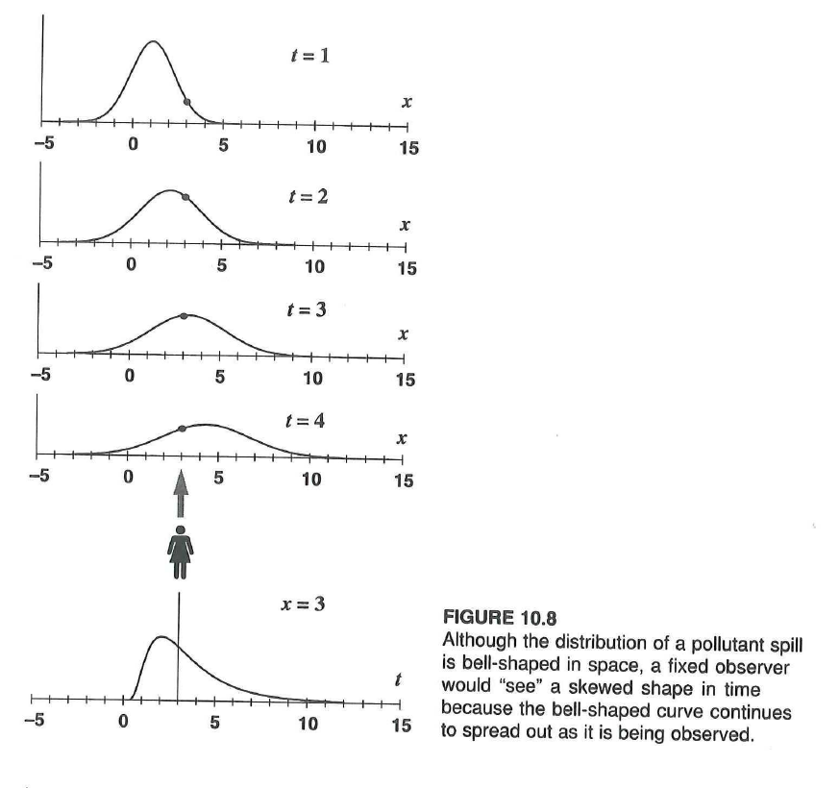
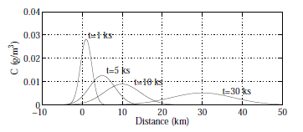
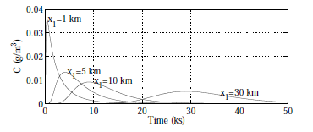
How does concentration change over time for an observer at fixed location?
Why for large distance, the apparent skewness seen by a fixed observer vanishes?
Group discussion.
Source: Chapra book

Slide 37
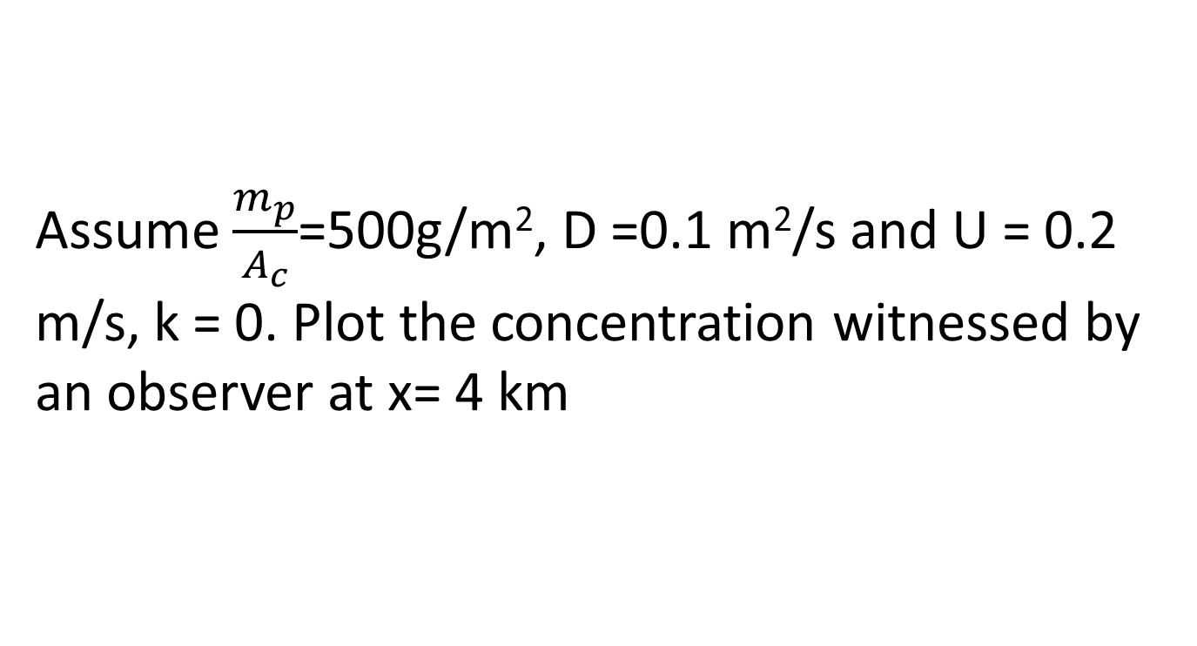
How does concentration change over time for an observer at fixed location?
Assume $\frac{m_{p}}{A_{c}}$=500g/m², D =0.1 m²/s and U = 0.2 m/s, k = 0. Plot the concentration witnessed by an observer at x= 4 km

Slide 38

1-D Alarm Model (Version 1.0): Taylor model
$$c(x,t)=\frac{m_{p}}{Q2\sqrt{πDt/U^{2}}}e^{−\frac{{(t−x/U)}^{2}}{4Dt/U^{2}}}$$
For an instantaneous point spill $W=m_{p}δ(t=0,x=0)$ and volumetric flow rate Q.

Slide 39
The Rhine Alarm Model: asymmetries in application
A_{b}
A_{b}
A_{s}
Dead zones with
stagnant water
Groynes

Slide 40


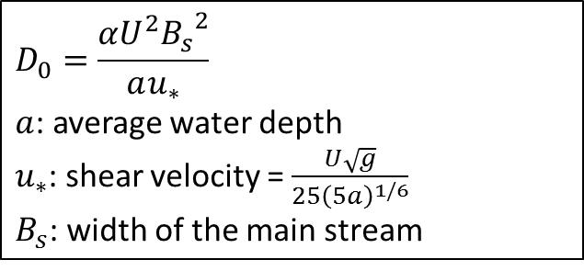
The Rhine Alarm Model version 2.0
Improvement: including stagnant zones
no analytical solution, Chatwin (1980) approximation
Includes transport velocity c
c = U / (1 + $β_{local}$)
- U : mean velocity in main stream
- $β_{local}=\frac{A_{b}}{A_{s}}$ (for the Rhine between 0 and 0.35); see previous slide
Skewness parameter
to calibrate
$$G_{t}=\frac{|g_{t}|}{|{σ_{t}^{}}^{3}|}$$
$g_{t}$= 3rd moment
$σ_{t}^{}$=variance or
2nd moment
Polynomial function
(3rd Hermite Polynomial)
$$H_{3}=z^{3}−3z$$
$z$=$\frac{{(t−x/c)}^{2}}{4D_{0}t/c^{2}}$
$$D_{0}=\frac{{αU}^{2}{B_{s}}^{2}}{au_{∗}}$$
$a$: average water depth
$u_{∗}$: shear velocity = $\frac{U\sqrt{g}}{25{\left(5a\right)}^{1/6}}$
$B_{s}$: width of the main stream
Notes:
H3: third Hermite polynomial H3(z)=z^3-3z
Last expression = 1 if no skew

Slide 41
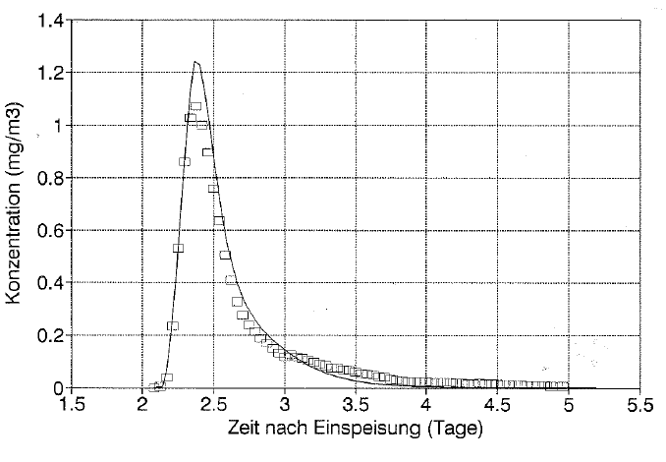
The Rhine Alarm Model
Model calibration
Tracer experiments to determine
Travel times of pollution clouds
Impounding and mixing in reservoirs
.. and to verify water travel times simulated with hydraulic models
Modeled concentration
Concentration mg/m³
Observed concentration
Time after release (days)
Source: Bettina Slides

Slide 42
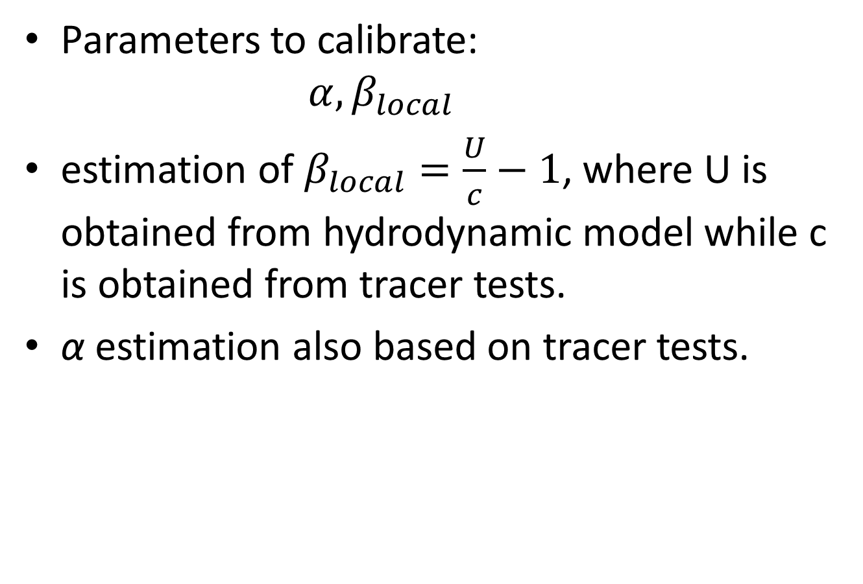
The Rhine Alarm Model calibration
Parameters to calibrate:
$$α, β_{local}$$
estimation of $β_{local}=\frac{U}{c}−1$, where U is obtained from hydrodynamic model while c is obtained from tracer tests.
α estimation also based on tracer tests.

Slide 43
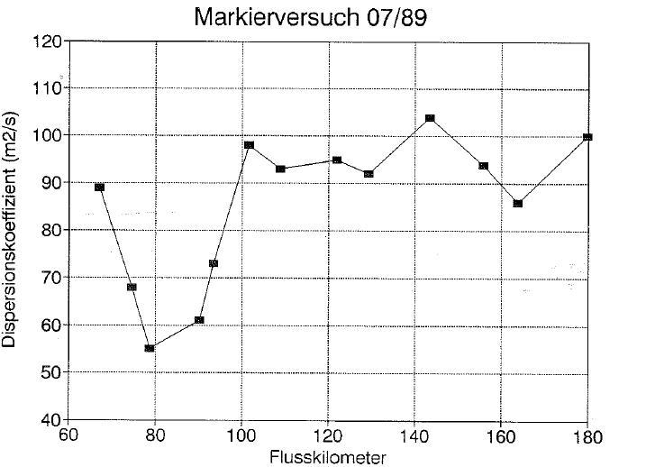
The Rhine Alarm Model
Dispersion coefficient (m²/s)
Origin of variations?
Hydropower plants?
River kilometer
Source
Basel
Notes:
An increase with distance, explanation for variations is not clear so far

Slide 44
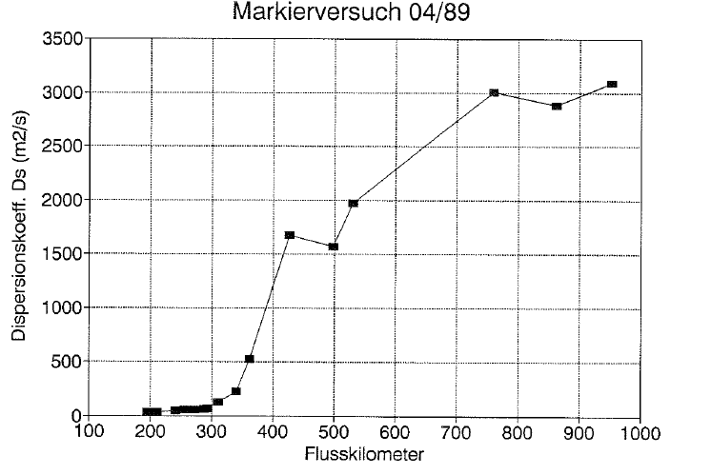
The Rhine Alarm Model
Waal
Dispersion coefficient (m²/s)
Dams
River kilometer
Basel
North Sea

Slide 45
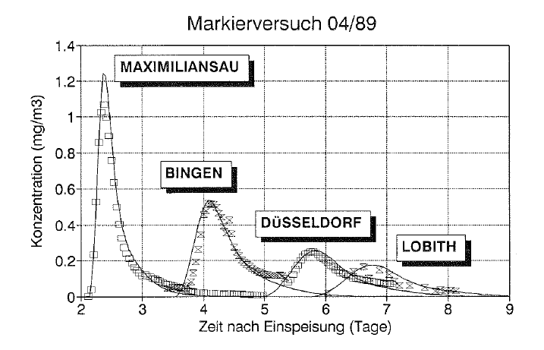
The Rhine Alarm Model
Skewed pollution wave
Concentration mg/m³
Time after release (days)

Slide 46
End of hour 3

Slide 47

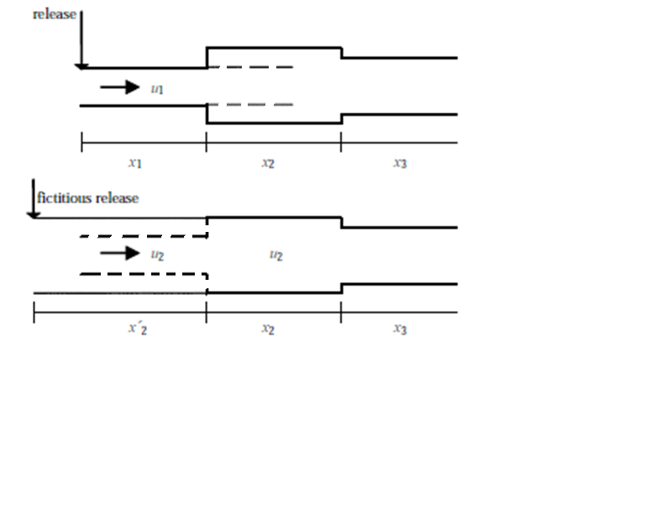
Alarm Model and different reaches
Form 1
(the original formulation)
Form 2
(the change of coordinate formulation)
Change Alarm model equation as it enters another reach – using the same equation but changing the coordinate system
Change coordinate system such that peak remains the same – How?

Slide 48
Different reaches: at the beginning of second reach (1)
Form 1: time to reach end of reach 1 (distance $x_{1}$), $t_{1}=x_{1}/u_{1}$
Form 2: time to reach end of reach 1 (distance ${x_{2}}^{′}$), ${t_{2}}^{′}={x_{2}}^{′}/u_{2}$
Maximum concentrations for both the forms should be the same, i.e.
${C_{form1}}^{max}(x_{1}\text{,}t_{1}\text{)}\text{=}$ $\frac{m_{p}}{A_{1}2\sqrt{πD_{1}t_{1}}}$
= ${C_{form2}}^{max}(x_{2}′\text{,}t_{2}′\text{)=}$ $\frac{m_{p}}{A_{2}2\sqrt{πD_{2}t_{2}}′}$

Slide 49

Different reaches: at the beginning of second reach (2)
Zo!
$\frac{m_{p}}{A_{1}2\sqrt{πD_{1}t_{1}}}\text{=}$ $\frac{m_{p}}{A_{2}2\sqrt{πD_{2}t_{2}′}}⇒ t_{2}^{′}={\left(\frac{A_{1}}{A_{2}}\right)}^{2}\frac{D_{1}}{D_{2}}t_{1}$

Slide 50
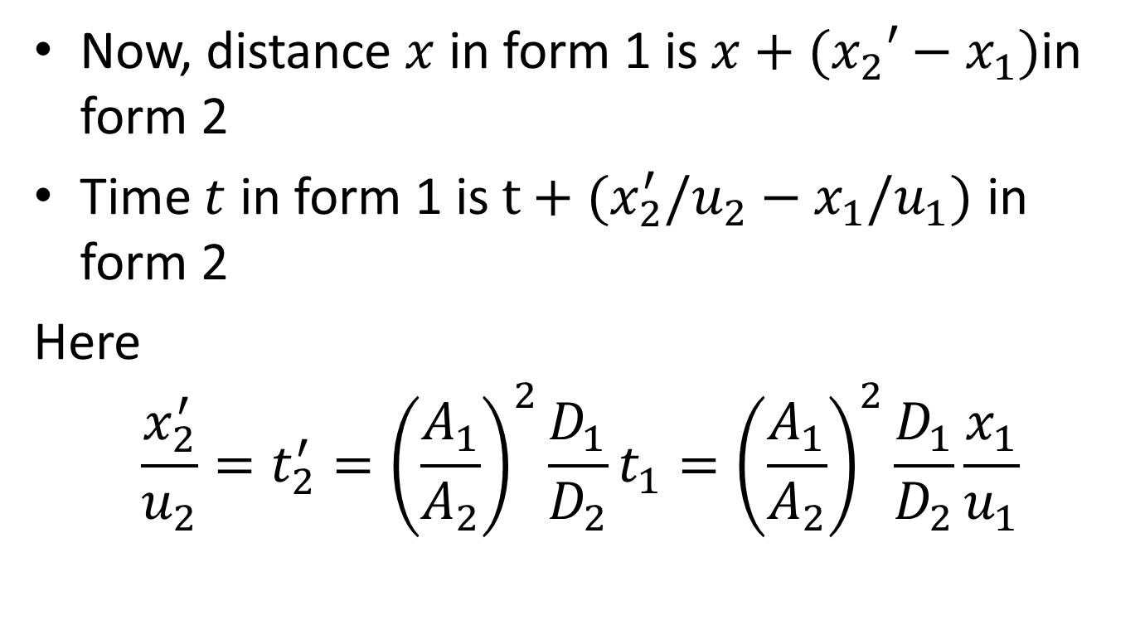
Form1 and Form2 equivalence
Now, distance $x$ in form 1 is $x+(x_{2}′−x_{1})$in form 2
Time $t$ in form 1 is $t+(x_{2}^{′}/u_{2}−x_{1}/u_{1})$ in form 2
Here
$$\frac{x_{2}^{′}}{u_{2}}=t_{2}^{′}={\left(\frac{A_{1}}{A_{2}}\right)}^{2}\frac{D_{1}}{D_{2}}t_{1}={\left(\frac{A_{1}}{A_{2}}\right)}^{2}\frac{D_{1}}{D_{2}}\frac{x_{1}}{u_{1}}$$

Slide 51
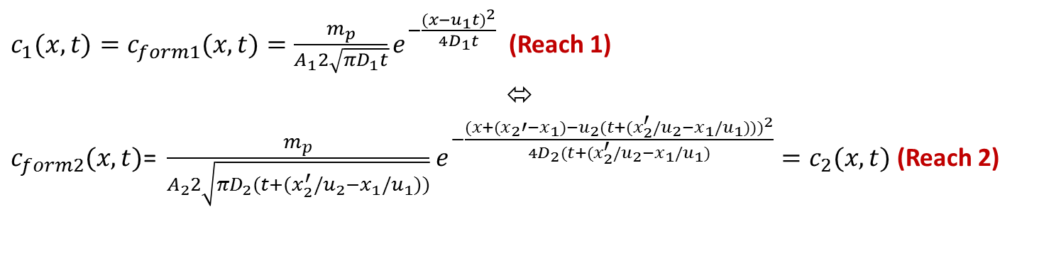
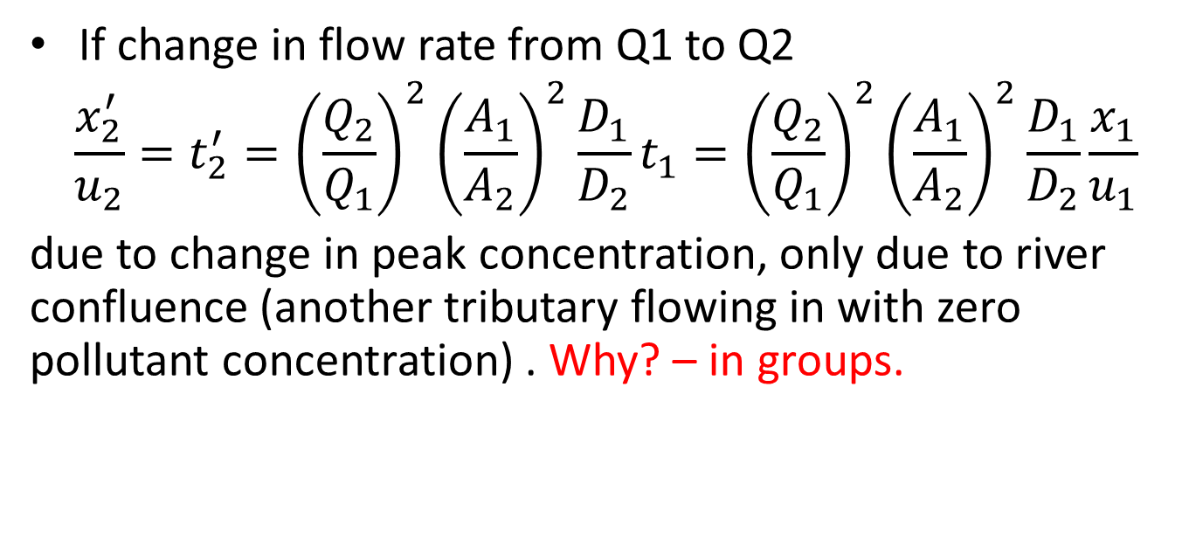
Form1 and Form2 equivalence
$c_{1}(x,t)=c_{form1}(x,t)=\frac{m_{p}}{A_{1}2\sqrt{πD_{1}t}}e^{−\frac{{(x−u_{1}t)}^{2}}{4D_{1}t}}$ (Reach 1)
⬄
$c_{form2}(x,t)\text{=} \frac{m_{p}}{A_{2}2\sqrt{πD_{2}(t+(x_{2}^{′}/u_{2}−x_{1}/u_{1}))}}$ $e^{−\frac{{(x+(x_{2}′−x_{1})−u_{2}(t+(x_{2}^{′}/u_{2}−x_{1}/u_{1})))}^{2}}{4D_{2}(t+(x_{2}^{′}/u_{2}−x_{1}/u_{1})}}=c_{2}(x,t)$ (Reach 2)
If change in flow rate from Q1 to Q2
$$\frac{x_{2}^{′}}{u_{2}}=t_{2}^{′}={\left(\frac{Q_{2}}{Q_{1}}\right)}^{2}{\left(\frac{A_{1}}{A_{2}}\right)}^{2}\frac{D_{1}}{D_{2}}t_{1}={\left(\frac{Q_{2}}{Q_{1}}\right)}^{2}{\left(\frac{A_{1}}{A_{2}}\right)}^{2}\frac{D_{1}}{D_{2}}\frac{x_{1}}{u_{1}}$$
due to change in peak concentration, only due to river confluence (another tributary flowing in with zero pollutant concentration) . Why? – in groups.

Slide 52
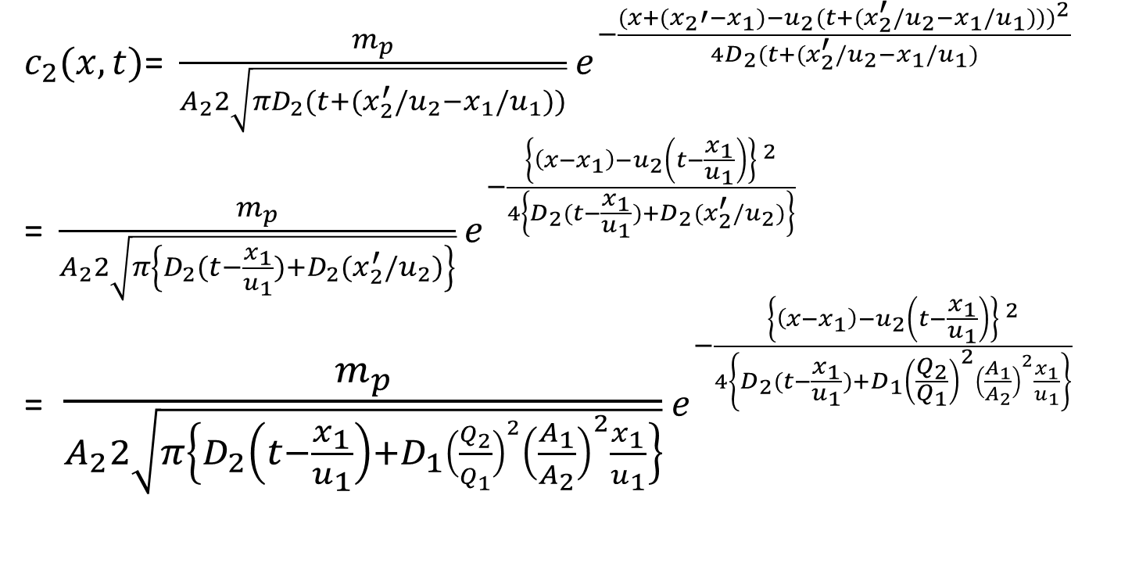
General form for second reach
$c_{2}(x,t)\text{=} \frac{m_{p}}{A_{2}2\sqrt{πD_{2}(t+(x_{2}^{′}/u_{2}−x_{1}/u_{1}))}}$ $e^{−\frac{{(x+(x_{2}′−x_{1})−u_{2}(t+(x_{2}^{′}/u_{2}−x_{1}/u_{1})))}^{2}}{4D_{2}(t+(x_{2}^{′}/u_{2}−x_{1}/u_{1})}}$
=$\frac{m_{p}}{A_{2}2\sqrt{π\left\{D_{2}(t−\frac{x_{1}}{u_{1}})+D_{2}(x_{2}^{′}/u_{2})\right\}}}$ $e^{−\frac{{\left\{\left(x−x_{1}\right)−u_{2}\left(t−\frac{x_{1}}{u_{1}}\right)\right\} }^{2}}{4\left\{D_{2}(t−\frac{x_{1}}{u_{1}})+D_{2}(x_{2}^{′}/u_{2})\right\}}}$
=$\frac{m_{p}}{A_{2}2\sqrt{π\left\{D_{2}\left(t−\frac{x_{1}}{u_{1}}\right)+D_{1}{\left(\frac{Q_{2}}{Q_{1}}\right)}^{2}{\left(\frac{A_{1}}{A_{2}}\right)}^{2}\frac{x_{1}}{u_{1}}\right\}}}$ $e^{−\frac{{\left\{\left(x−x_{1}\right)−u_{2}\left(t−\frac{x_{1}}{u_{1}}\right)\right\} }^{2}}{4\left\{D_{2}(t−\frac{x_{1}}{u_{1}})+{D_{1}\left(\frac{Q_{2}}{Q_{1}}\right)}^{2}{\left(\frac{A_{1}}{A_{2}}\right)}^{2}\frac{x_{1}}{u_{1}}\right\}}}$

Slide 53
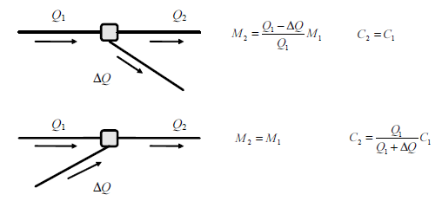
Rhine Alarm Model: different reaches
In case of bifurcations, replace mp by (Q2/Q1)mp due to loss of pollutant mass as a result of bifurcation but remove the effect of Q in peak concentration .
bifurcation
confluence

Slide 54
End of hour 4

